Slide 1
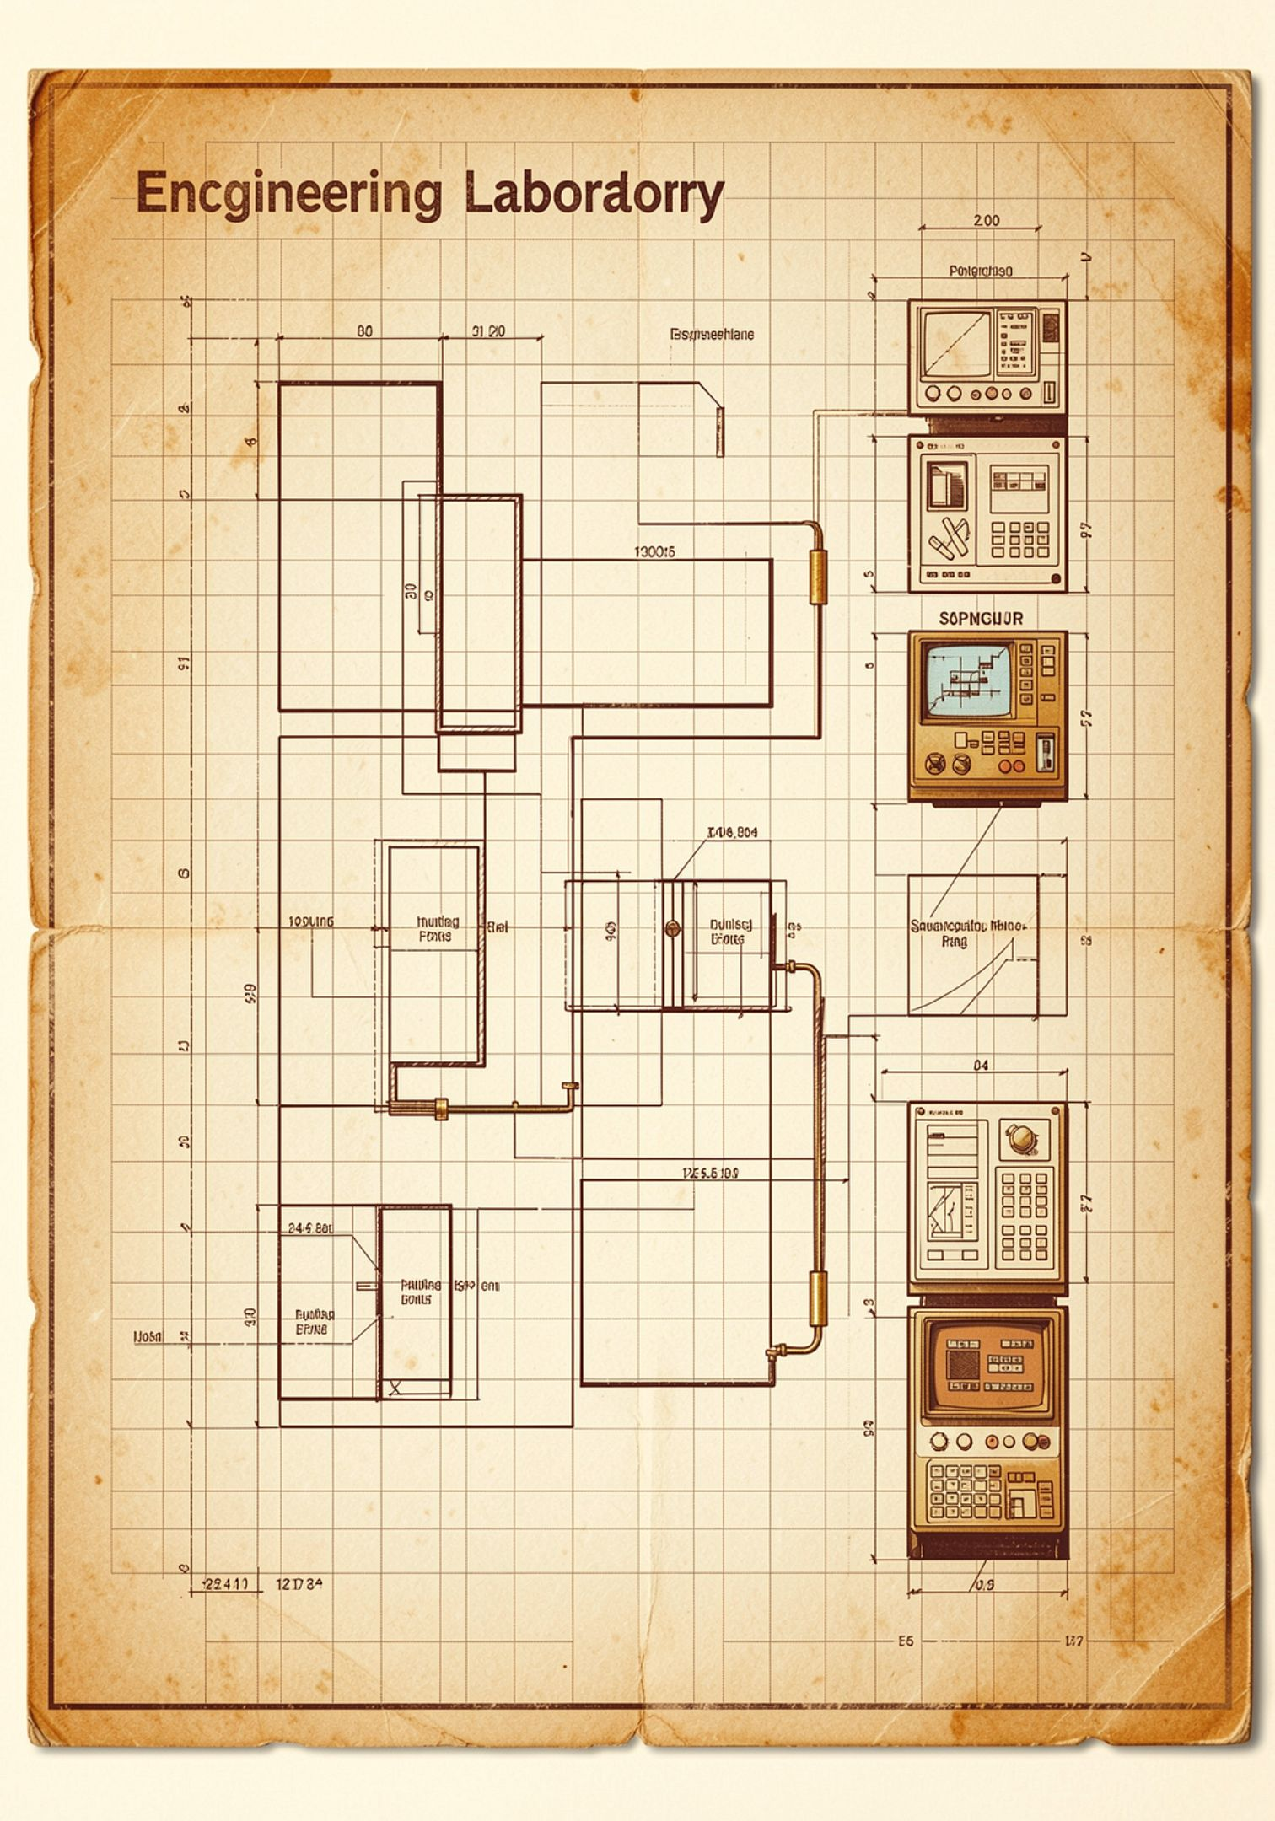
SyncCode NextGen
AI-Assisted Real-Time Collaborative Development Environment
A unified browser-based IDE integrating real-time synchronisation, intelligent AI assistance, and privacy-first security — purpose-built for modern collaborative software engineering.
LEAD DEVELOPER
INSTITUTION
Rudraksh Kumar
GL Bajaj Institute of Technology & Management
with Sandeep Kushwaha · Sagar Gautam · Sanjay Prajapati
SyncCode NextGen • GL Bajaj Institute of Technology & Management

Slide 2
Problem Statement & Motivation
Contemporary collaborative software engineering remains deeply fragmented. Developers are forced to context-switch across standalone editors, external chat platforms, file-sharing services, separate version-control dashboards, and disconnected AI utility tools — each operating in isolation, with no unified state or shared awareness.
The Fragmentation Problem
Engineering Objectives
No single environment unifies editing, communication, and versioning
Real-time cursor and presence awareness is absent in most IDEs
AI tools operate outside the editing context, breaking developer flow
Offline recovery and encrypted persistence are rarely prioritised
Design a browser-native, room-based collaborative IDE with zero installation overhead
Implement sub-second synchronisation via Socket.IO and experimental WebRTC peering
Integrate an AI layer for code assistance, review, bug detection, and test generation
Enforce end-to-end privacy through JWT authentication, AES-GCM encryption, and isolated code execution
SyncCode NextGen • GL Bajaj Institute of Technology & Management

Slide 3
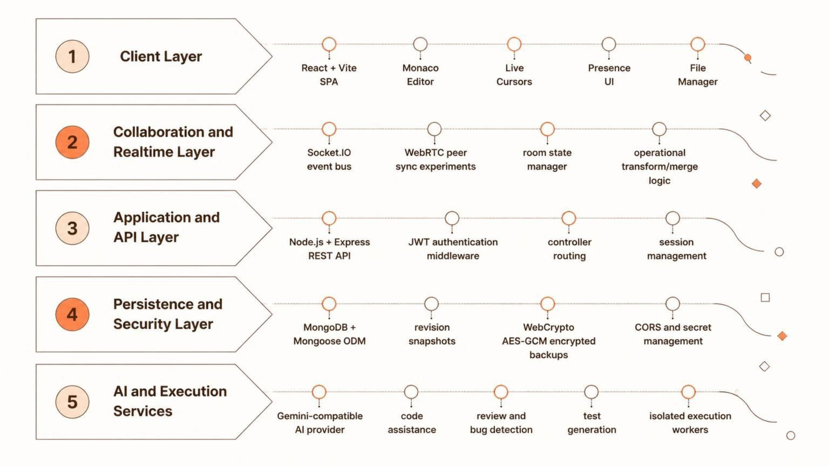
System Architecture
SyncCode NextGen is structured as a five-layer distributed system. Each layer encapsulates a distinct engineering concern — presentation, real-time transport, application logic, persistence and security, and AI/execution services — communicating through well-defined interfaces.
Arrows flow top-to-bottom during a user request and bottom-to-top during AI/execution callbacks, ensuring clean separation of concerns across the full stack.
SyncCode NextGen • GL Bajaj Institute of Technology & Management

Slide 4
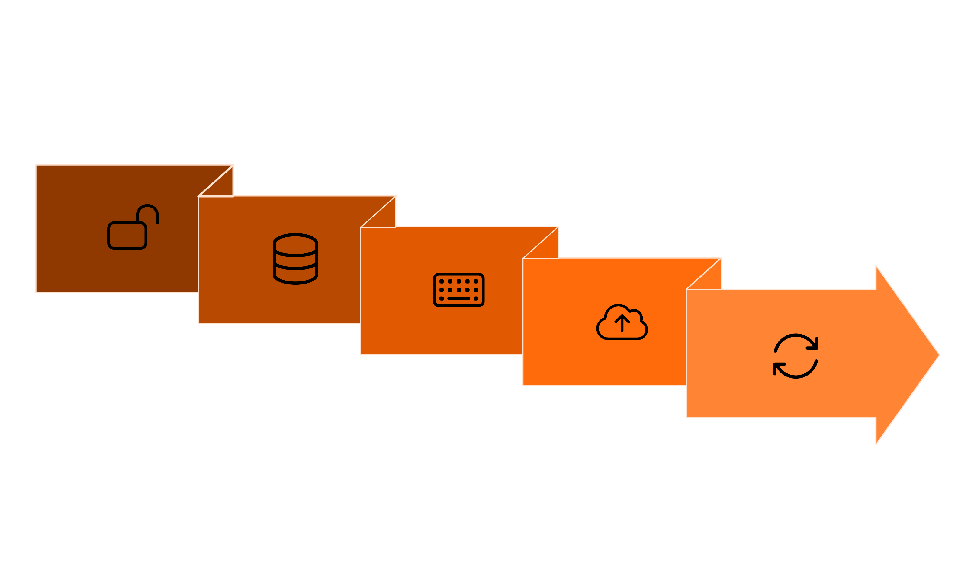
End-to-End Workflow
Every user interaction in SyncCode NextGen follows a deterministic, observable path through the system — from room entry to final output — ensuring consistency, recoverability, and AI augmentation at each stage.
Open & Authenticate
Edit & Sync
Output & Recover
Load Project & Join
Persist, Execute & AI
Each step is independently recoverable — if a peer disconnects mid-session, the revision history and encrypted local snapshot allow full state restoration upon reconnection.
SyncCode NextGen • GL Bajaj Institute of Technology & Management

Slide 5








Core Features & Capability Pipeline
SyncCode NextGen exposes a structured capability pipeline — from raw user action through the collaboration engine, security layer, and AI/execution services — delivering a unified developer experience with no external tool switching required.
Editor & File State
Collaboration Engine
Monaco Editor, multi-file tabs, live cursors, presence indicators
Socket.IO deltas, peer sync, conflict merge, room isolation
Revision & Recovery
AI & Execution
Version snapshots, diff viewer, encrypted local backup, restore
Code assist, review, bug detection, test gen, isolated execution workers
Live Presence
AI Agent Layer
Named cursors, colour-coded per peer, real-time scroll and caret tracking
Gemini-compatible provider for inline assist, agent planning, and workflow automation
E2EE Experiments
Sandboxed Execution
AES-GCM encrypted backups and room-level encryption prototypes
Execution manager dispatches to isolated workers; output streamed back to client
SyncCode NextGen • GL Bajaj Institute of Technology & Management

Slide 6


Project Structure, Implementation & Security
Repository Layout
Security Architecture
E:\SyncCode-NextGen\
├── client\ (React + Vite)
│ └── src\
│ ├── pages\ (Room, Auth, Dashboard)
│ ├── components\ (Editor, FileTree, AI Panel)
│ ├── hooks\ (useSocket, useRoom, useAI)
│ ├── services\ (api.js, socket.js, ai.js)
│ └── lib\ (crypto, diff, storage)
└── server\ (Node.js + Express)
├── controllers\ (auth, room, file, exec)
├── routes\ (REST API definitions)
├── models\ (User, Room, Revision)
├── middleware\ (JWT, CORS, validation)
└── services\ (AI bridge, exec manager)
Authentication
JWT-signed tokens, bcrypt password hashing, session expiry and refresh
Transport & API
CORS whitelisting, environment-variable secret management, input validation middleware
Data & Execution
WebCrypto AES-GCM encrypted local backups, room-level isolation, sandboxed execution workers, no persistent plaintext secrets
SyncCode NextGen • GL Bajaj Institute of Technology & Management

Slide 7

Evaluation, Contributions & References
Evaluation Dimensions
References
Synchronisation Latency
IEEE Xplore Digital Library — Collaborative systems and real-time synchronisation research
RFC 6455 — The WebSocket Protocol (IETF)
Socket.IO delta propagation observed to be consistently low on LAN and moderate on WAN; acceptable for collaborative editing scenarios
Socket.IO Documentation — Real-time bidirectional event-based communication
React Documentation — Component model and hooks API reference
Recovery Reliability
Encrypted local snapshot and MongoDB revision history together enable full session recovery after peer disconnection or browser crash
Monaco Editor — Microsoft's browser-based code editor
MongoDB Documentation — Document model and Mongoose ODM
AI Utility
Gemini-compatible provider delivers contextually relevant suggestions, review annotations, and test stubs with acceptable round-trip latency
Web Crypto API — W3C cryptographic primitives in the browser
WebRTC — Peer-to-peer communication APIs
Execution Isolation
Project GitHub Repository — SyncCode NextGen source code
GL Bajaj Institute of Technology & Management — Greater Noida
Worker-based execution manager prevents host-process pollution; output correctly streamed back to requesting client
Research Contributions & Future Scope
SyncCode NextGen demonstrates a cohesive architecture unifying real-time collaboration, encrypted persistence, and AI-augmented development within a single browser-native environment. Future work includes full OT/CRDT-based conflict resolution, production-grade E2EE, offline-first PWA support, and multi-language execution sandboxing.
SyncCode NextGen • GL Bajaj Institute of Technology & Management

